Slide 1
UNIT - I
Introduction to Management

Slide 2
Contents
Introduction
Definition of Management
Nature of Management
Purpose and functions of Management
Levels and types of Managers
Mmanagerial Roles
Skills for Managers
Evaluation of Management Thoughts

Slide 3
Oragnization
An organization is a deliberate arrangement of people, processes, and resources, structured to work together for a common, specific purpose that individuals alone could not achieve.
It provides a systematic framework for coordination, communication, and decision-making, featuring defined roles, hierarchies, and responsibilities to facilitate efficient operations and goal attainment.
Organizations can take many forms, from businesses and government agencies to non-profit groups, and the term can also refer to the act of arranging things in a structured and systematic way.

Slide 4
Key Aspects of an Organization
Purpose:
Each organization has a shared goal or objective that guides its actions and structure.
Structure:
A defined hierarchy, roles, and responsibilities are established to coordinate activities and ensure everyone knows their place.
People:
Organizations are composed of individuals who work together, contributing their skills and efforts toward the collective aim.
Resources:
They utilize various resources, such as capital, materials, and tools, to function and achieve their objectives.
Coordination & Communication:
Systems are in place to facilitate communication and the coordination of different activities and departments.

Slide 5
Types and Examples of Organisation
For-profit businesses: Companies aimed at making a profit.
Non-profit organizations: Entities like charities and foundations working for a social cause.
Government agencies: Public bodies that provide services or enforce laws.
Educational institutions: Schools, colleges, and universities.
Community groups: Local associations formed around shared interests or goals.

Slide 6
Definition of Management
Management is the process of planning, organizing, leading, and controlling an organization's resources (including people, money, and materials) to achieve specific goals effectively and efficiently.
It involves coordinating the efforts of a group to accomplish objectives, often in a structured way, by setting goals, creating plans, assigning tasks, and overseeing the entire workflow.
In summary, Management is about handling people and processes in a way that gets results, without wasting time or resources. It is a universal process found in all types of organizations, from businesses to non-profits and government agencies.

Slide 7
Key Aspects of Management
Goal Achievement: The primary purpose is to achieve predetermined objectives.
Resource Utilization: It involves the effective and efficient use of all available resources, such as human, financial, and material.
People-Centric: A core element is working with and through people to get things done.
Process-Oriented: Management is a continuous process that involves several key functions:
Planning: Setting goals and outlining the steps to achieve them.
Organizing: Structuring the work and allocating resources.
Leading/Directing: Guiding, motivating, and supervising people to perform tasks.
Controlling: Monitoring progress and taking corrective actions to ensure goals are met.
Environment Design: Managers create and maintain a conducive environment for groups to work effectively.

Slide 8
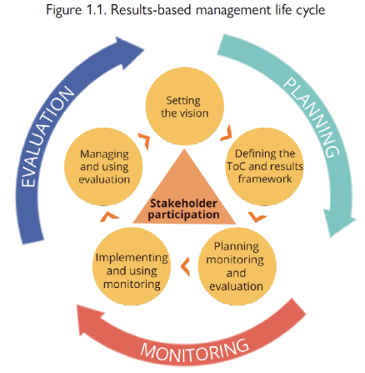
Evaluation of Management

Slide 9
Evaluation of Management
Evaluation of management is a systematic process that assesses how well managers and organizations are performing against objectives and plans, focusing on areas like leadership, strategic alignment, and team outcomes to drive continuous improvement.
Methods include combining subordinate and peer feedback with performance metrics, self-assessments, and appraisal interviews to identify strengths and weaknesses and inform future strategies.
The goal is to enhance future performance, inform decision-making, and ensure goals are met effectively.

Slide 10
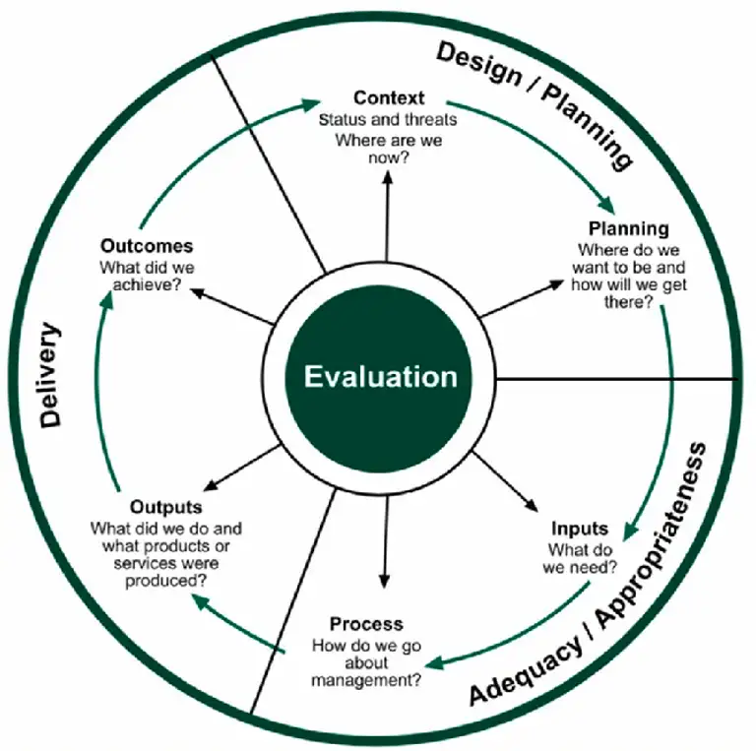
Evaluation of Management

Slide 11
Need of Management
Management is necessary to coordinate group efforts, achieve organizational goals, and use resources efficiently by providing direction, planning, organizing, and controlling activities.
It helps businesses adapt to change, foster innovation, increase productivity, and ensure stability and growth, which ultimately benefits employees, customers, and society.

Slide 12
Why Management Needed
Achieving Goals:
Management provides clear direction and aligns individual efforts towards common organizational goals, making them achievable and efficient.
Resource Optimization:
It ensures that scarce resources like time, money, and manpower are used effectively and optimally, reducing waste and increasing productivity.
Efficiency and Productivity:
By streamlining operations, setting clear processes, and motivating staff, management improves overall efficiency and boosts output.
Adaptability to Change:
Management helps organizations navigate dynamic environments by anticipating and adapting to market changes, technological advancements, and evolving customer demands.

Slide 13
Why Management Needed
Innovation and Growth:
It fosters a creative environment for new ideas, encouraging research, innovation, and the development of new products or services to maintain a competitive edge.
Coordination and Stability:
Management coordinates the work of various divisions and teams, ensuring smooth operations and stability within the organization.
Employee Satisfaction and Motivation:
It creates a positive work atmosphere, fosters teamwork, and provides employees with clear responsibilities and opportunities for development, leading to higher job satisfaction and commitment.
Societal Contribution:
Beyond profit, management helps organizations fulfill social responsibilities by providing quality goods and services, creating employment, and contributing to the economy and societal development.

Slide 14
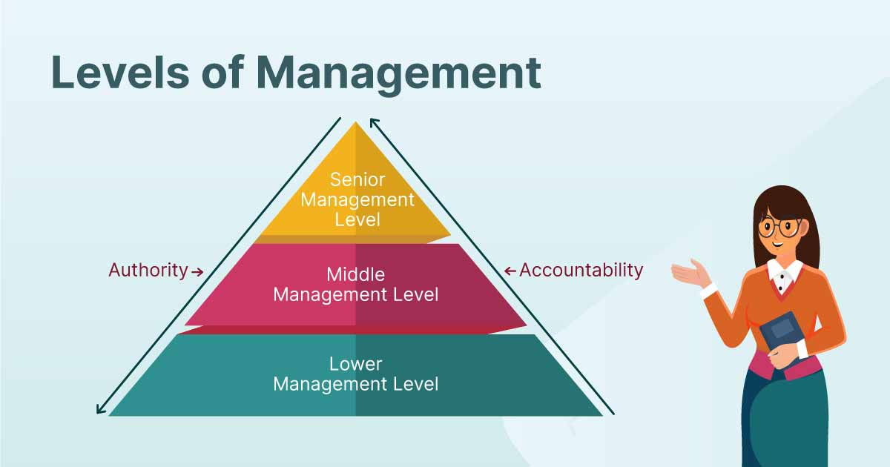
Levels of Management

Slide 15
Levels of Management
The three main levels of management are Top-Level, Middle-Level, and Lower-Level (or First-Line) management, each with distinct roles, responsibilities, and examples.
Top-level managers (like CEOs) focus on strategic goals and overall organizational direction.
Middle managers (such as department heads) translate these strategies into actionable plans for their specific units.
Lower-level managers (like supervisors) directly oversee day-to-day operations and front-line employees to ensure tasks are completed efficiently.

Slide 16
Characteristics of Management
Management is a distinct process.
Management is an organized activity
Management aims at the accomplishment of predetermined objectives.
Management is both a science and an art.
Management is a group activity
Management principles are universal in nature
Management integrates human and other resources.

Slide 17
Features of the Management
Management involves five functions
These functions are organized to achieve organizational goals.
Management involves effective and efficient use of resources.

Slide 18
FUNCTIONS OF MANAGEMENT
PLANNING
ORGANIZING
STAFFING
DIRECTING
CONTROLLING

Slide 19
PLANNING
Planning is determining the objectives and formulating the methods to achieve them. It is more simply said than done. A job well planned is half done. During planning one needs to ask oneself the following:
What am I trying to accomplish i.e. what is my objective?
What resources do I have and do I need to accomplish the same?
What are the methods and means to achieve the objectives?
Is this the optimal path?

Slide 20
Types of Planning
Purposes or missions,
Objectives-It is the ultimate goal towards which the activities of the organization are directed
Strategies-general program of action and deployment of resources
Policies-general statement or understanding which guide or channel thinking in decision making
Procedures-states a series of related steps or tasks to be performed in a sequential way
Rules-prescribes a course of action and explicitly states what is to be done
Programs-comprehensive plan that includes future use of different resources
Budgets-statement of expected results expressed in numerical terms

Slide 21
Principles of Planning
Take Time to Plan
Planning can be Top to Down or Bottom to Top
Involve and Communicate with all those Concerned
Plans must be Flexible and Dynamic
Evaluate and Revise

Slide 22
Steps in Planning
Determining the goals or objectives for the entire organization.
Making assumptions on various elements of the environment.
To decide the planning period.
Examine alternative courses of actions.
Evaluating the alternatives.
Real point of decision making
To make derivative plans.

Slide 23
Types of Managerial Decisions
Programmed
Non programmed.
Mechanistic-It is one that is routine and repetitive in nature
Analytical-It involves a problem with a larger number of decision variables
Judgmental-It involves a problem with a limited number of decision variables, but the outcomes of decision alternatives are unknown
Adaptive-It involves a problem with a large number of decision variables, where outcomes are not predictable

Slide 24
Process of Organizing
Determine what is to be done/ Division of Work:
Assign Tasks: Departmentalization:
Link Departments: Hierarchy Development:
Decide how much Authority to Designate/ Authority, Responsibility and Delegation:
Decide the Levels at which Decisions are to be made / Centralization vs. Decentralization:
Decide how to Achieve Coordination:

Slide 25
Techniques for achieving coordination
Coordination by Rules or Procedures
Coordination by Targets or Goals:
Coordination through the Hierarchy
Coordination through Departmentalization
Using a Staff Assistant for Coordination:
Using a Liaison for Coordination:
Using a Committee for Coordination
Using Independent Integrators for Coordination:
Coordination through Mutual Adjustment:

Slide 26
STAFFING
Definition 1
Selecting and training individuals for specific job functions, and charging them with the associated responsibilities.
Definition 2
Number of employed personnel in an organization or program. Also called workforce.

Slide 27
DIRECTING/LEADING
Provides positive and dynamic leadership
Provides maximum opportunities
Provides proper motivation of personnel
Ability to command people

Slide 28
CONTROLLING CONCEPTS
Feed Forward Control-Control that attempts to identify and prevent deviations before they occur is called feed forward control, sometimes called preliminary or preventive control.
Concurrent Control-Control that monitors ongoing employee activities during their progress, to ensure they are consistent with quality standards, is called concurrent control.
Feedback Control-In this case, the control takes place after the action. Sometimes called post-action or output control

Slide 29
Steps in the Control Process
Establish Standards of Performance
Measure Actual Performance
Compare Performance to Standards:
Take Corrective Action

Slide 30
Principles of Effective Control
Effective controls are timely.
Control standards should encourage compliance.
Setting effective standards is important
Use management by exception.
Employees should get fast feedback on performance.
Do not over rely on control reports.
Fit the amount of control to the task.

Slide 31
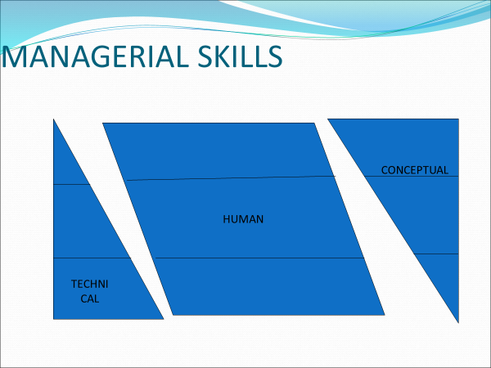
MANAGERIAL SKILLS

Slide 32
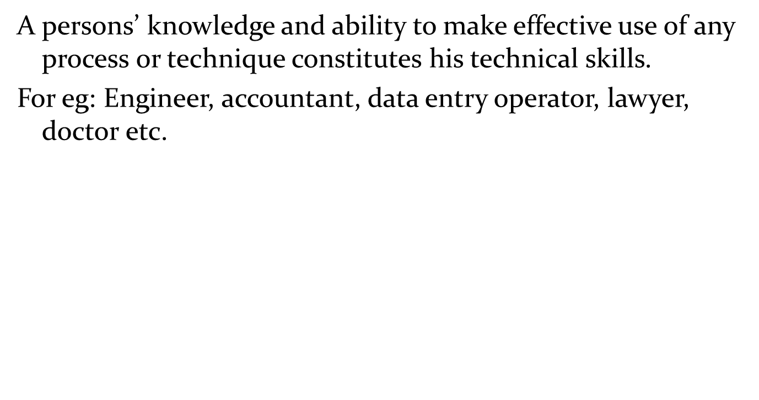
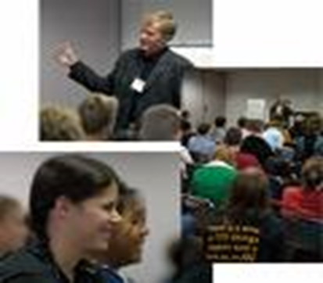
TECHNICAL SKILLS

Slide 33
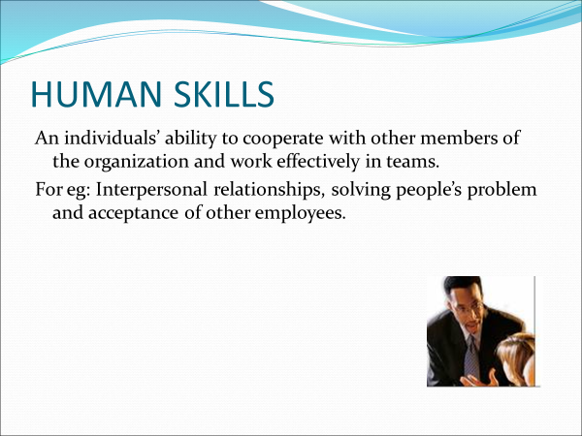
Human Skills

Slide 34
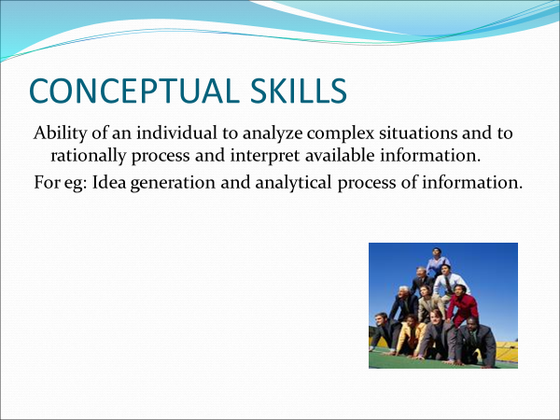
Conceptual skills

Slide 35
Manager’s Role
Interpersonal role
Informational role
Decisional role

Slide 36
INTERPERSONAL ROLE
Figurehead- ethical guidelines and the principles of behavior employees are to follow in their dealings with customers and suppliers
Leader- give direct commands and orders to subordinates and make decisions
Liaison-coordinate between different departments and establish alliances between different organizations

Slide 37
INFORMATIONAL ROLE
Monitor- evaluate the performance of managers in different functions
Disseminator-communicate to employees the organization’s vision and purpose
Spokesperson- give a speech to inform the local community about the organization’s future intentions

Slide 38
DECISIONAL ROLE
Entrepreneur- commit organization resources to develop innovative goods and services
Disturbance handler- to take corrective action to deal with unexpected problems facing the organization from the external as well as internal environment
Resource allocator- allocate existing resources among different functions and departments
Negotiator- work with suppliers, distributors and labor unions

Slide 39
TYPES OF MANAGERS
FIRST-LINE MANAGERS- often called supervisors stand at the base of the managerial hierarchy
MIDDLE MANAGERS- heads of various departments and organise human and other resources to achieve organizational goals
TOP MANAGERS- set organizational goals, strategies to implement them and make decisions

Slide 40
WHAT MAKE MANAGERS SUCCESSFUL?
Hard work
Smart work
Patience
Out of box thinking
Reading and acquiring knowledge
Ethical consciousness
Collaborative relationship
Perseverance

Slide 41
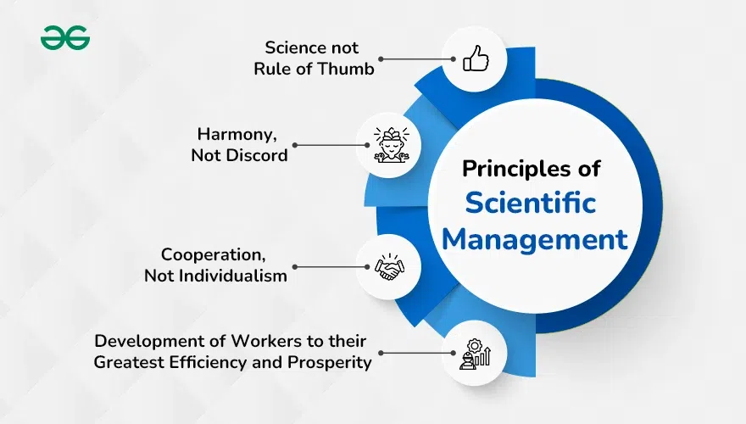
Introduction to Scientific Management

Slide 42
Principles of Scientific Management
Scientific Management is a management technique that utilizes scientific methods to enhance workforce efficiency.
It uses scientific methods that include systematic, objective, and logical principles and techniques to solve management problems.

Slide 43
What is Scientific Management?
The use of scientific principles and techniques in various managerial functions is known as scientific management.
It is the art of knowing exactly what you want your employees to do and seeing that they do it in the best and cheapest ways.
It involves the study of each activity in detail and doing the work in such a manner so that work can be completed effectively and efficiently.

Slide 44
What is Scientific Management?
In the words of Lawrence A. Appley:
"Scientific Management is a conscious orderly human approach to the performance of management responsibilities as contrasted with the day-in and day-out rule of thumb, hit or miss approach''.

Slide 45
What is Scientific Management?
In the words of F.W. Taylor:
"Scientific management is the art of knowing exactly what you want your men to do and then seeing that they do it in the best and cheapest way."

Slide 46
Scientific Management?
F.W. Taylor's scientific management is based on the following four principles:
1. Science, not Rule of Thumb
2. Harmony, Not Discord
3. Cooperation, Not Individualism
4. Development of Workers to their Greatest Efficiency and Prosperity

Slide 47
Thank you

